Slide 1
Tempest Books Store
Research & Development for Tempest Books Store
By Thi Han Naing

Slide 2
Table of contents
01.
Introduction
03.
Project Plan
02.
Proposal
04.
Analysis
Will include all time boxes and etc.
Will explain about current system
Will include about proposed system
Will include all analysis that are included.

Slide 3
Table of contents
05.
06.
Design
Development
07.
09.
08.
Deployment
Conclusions
Evaluation
>
<
Will include diagram and prototypes
Will include about coding and etc.
>
<
<
Will include about deployment details
References and other factors will be included
Will include detailed evaluation
<

Slide 4
Introduction
01
Thi Han Naing
Enrolled in NCC Level 5 after passing Level 4.
20 years old, passionate about software development.
Finished Level 4 and knowledge from other programs.
Excitedly learning new knowledge and skill in Level 5.

Slide 5
Introduction for current business
01
Store is located in Yangon, Myanmar tending to get more customers.
Originally target young adults and teenagers by selling comic books online.
Later opened a physical store to target more customer regardless of age.
Introduction a “Online Book Selling System” for a secure, convenient, sophisticated and visual appealing.

Slide 6
Strength and Weakness of Current System
Strength
Can explore real books in real life
Have great vibes in the store
Able to read some pages of the books
Weakness
Has some inconvenience for customers.
Take some time to finish the processes.
Cannot able to explore 24 hours.

Slide 7
02
Proposal
Proposed system explanation and scope

Slide 8
Proposal
Comparison
Analysis
New System
Aims & Objectives
Similar systems will be compared.
Current system will be analyzed
Will solve current system’s problems
Cost and goals will be included.

Slide 9
Proposal
Costs
New System Analysis
Methodology
Costs for proposed system will include.
Will have analysis before implementing
Chosen methodology flow will be explained

Slide 10
Project Plan
03
There are analysis and feasibility studies.
Developments of a system.
Deployment plans.
Risk Management plans.

Slide 11
Project Plan
Analysis
Deployment
Like in introduction
Plans, diagram and explanations
Project Plan
Diagrams
Time-boxes
Earth is the third planet from the Sun and the only one that harbors life in the Solar System. This is where we all live
Use-case, class, and sequence diagrams
Timeboxes usages and importance.
Iteration
Risk
Iteration steps and processes
Management, identification and matrix included.

Slide 12
04
Analysis
Analysis is the necessary in any types of project. There will also be analysis methods in this project.

Slide 13
Analysis
SWOT Analysis for old system.
Strength and weakness for technical feasibilities and current system
Risk analysis for potential issues and problems
MOSCOW prioritization plans to make project finish in time
Legal, Ethical, Social, and Professional Issues predictions

Slide 14
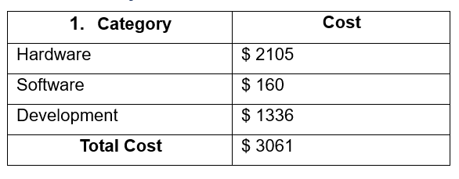
Cost Estimation
These are cost estimations after analyzing them from real word used the necessaries.

Slide 15
05
Design
Designing diagram for development and prototypes are needed to make the project successfully finished within time limitations.

Slide 16
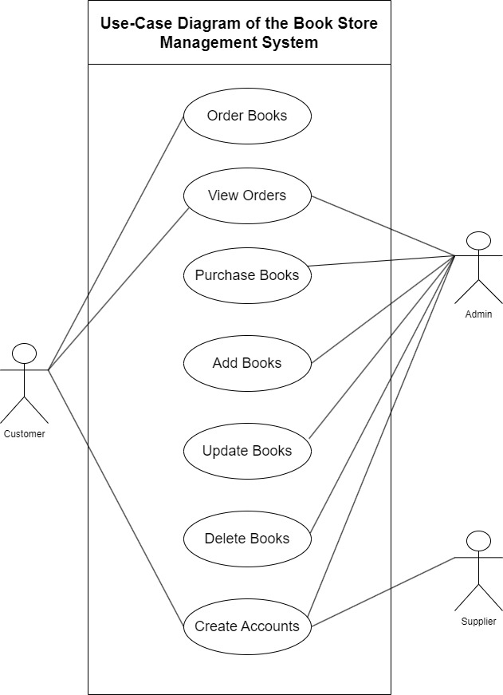
Use Case Diagram
Use case is crucial in software development projects.
By reading use case, the system scope can be understand.
There are three actors but two main actors who will do data changes.
The figure shows the use case diagram of the book store management system for Tempest Books Store.

Slide 17
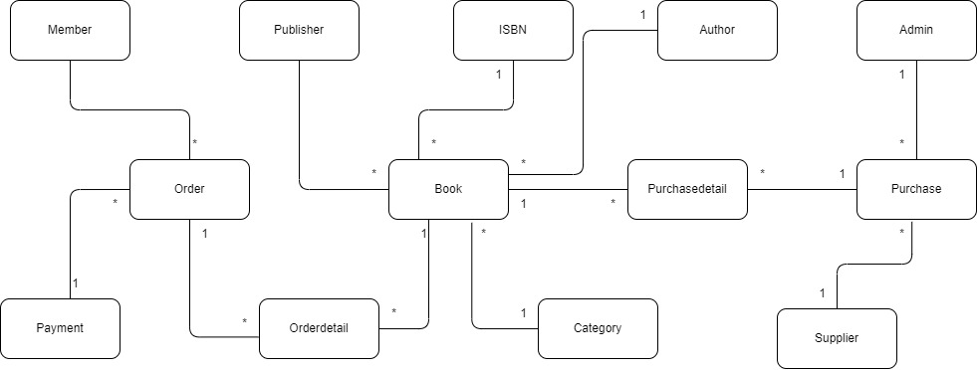
Class Diagram
This is the initial class diagram.
These entities will help with creating database.
Reading this use case will help to understand how system connection and flow

Slide 18
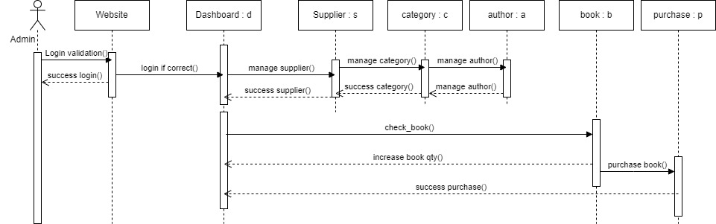
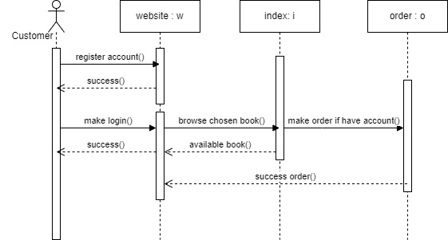
Sequence Diagram
Sequence Diagrams will let the team and stakeholders understand the sequence flow the system.
After reading this, they will know the steps they will have to do.

Slide 19
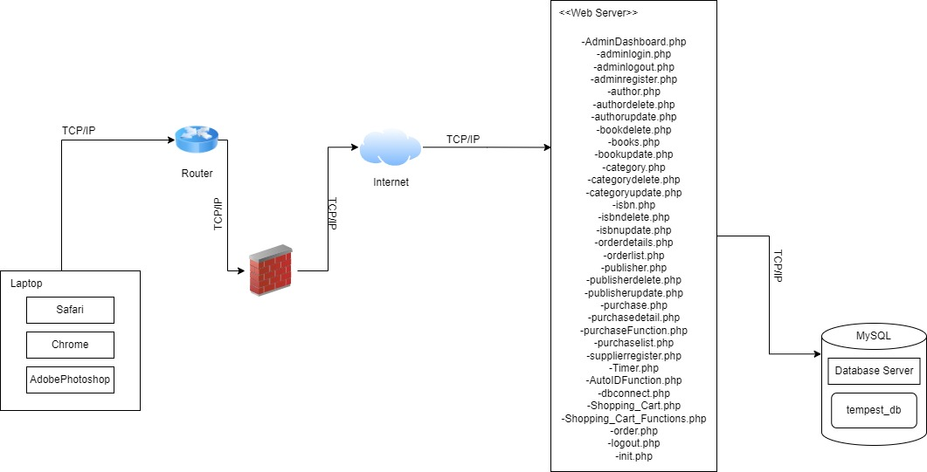
Deployment Diagram
This is the deployment diagram and reading this will helps stakeholders and project manger knows the steps and working structure of deploying the system.

Slide 20
Prototypes
Low-Level
High-Level
Low-level prototypes are included to get reviews and satisfactions from admins and confirmation of interface design
Designs for customer side website and they are iterated by client’s request

Slide 21
06
Development
Coding which include both frontend and backend technologies

Slide 22
Development
Backend
PHP and MySQL are used for backend development.
Frontend
HTML, Tailwind CSS, and JavaScript are used for frontend development

Slide 23
Applications Used
Visual Studio Code
XAMMP
This IDE is used for frontend development and PHP. This IDE is free to use and has many extensions.
To create database and using of MySQL. Can run PHP codes on local host. This application is free to use.

Slide 24
07
Deployment
Deploying the system without errors is really important.

Slide 25
Deployment
Deployment Plan
Training
Deployment plans and diagram are created and negotiated with clients.
In the plan all detailed requirement are included.
There are also training plans for the users to know more about the system processes.

Slide 26
Evaluation
08
After the project is done, evaluation are documented.
Included about aim & objectives evaluation and others.

Slide 27
Other Evaluation
Evaluation against similar system.
Evaluation against justification made.
Evaluation against timebox plans.
Personal evaluation.
Evaluation for current system.

Slide 28
09
Conclusion
Conclusion for the project presentation.

Slide 29
Conclusion
References
Appendix
Challenges
All the reference I made are described.
Some documentations are provided in appendix.
Gave lots of experiences and knowledge

Slide 30
Thanks
Do you have any questions?
Feel free to ask.
thnaing1@kmd.edu.com
+95 979 966 9265

